Slide 1
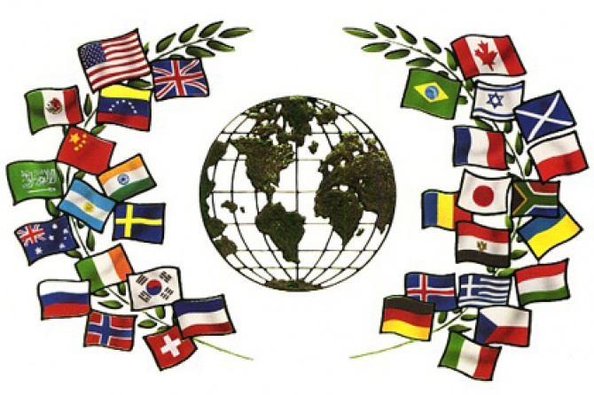
European Day of Languages
26th September

Slide 2
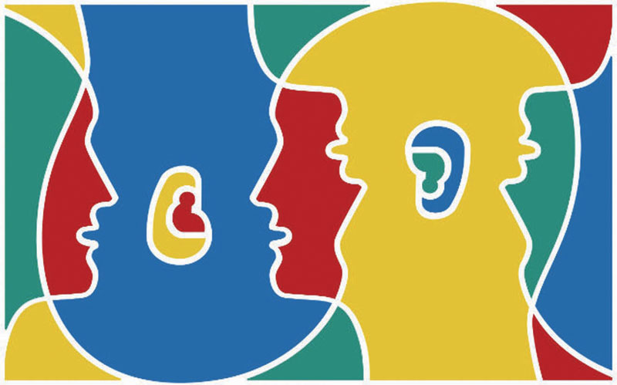
At the initiative of the Council of Europe, Strasbourg, the European Day of Languages has been celebrated every year since 2001 on 26 September.

Slide 3
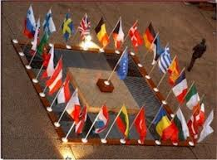
Throughout Europe, 800 million Europeans represented in the Council of Europe's 47 member states are encouraged to learn more languages, at any age, in and out of school.
Being convinced that linguistic diversity is a tool for achieving greater intercultural understanding and a key element in the rich cultural heritage of our continent, the Council of Europe promotes plurilingualism in the
whole of Europe.

Slide 4
Why do we celebrate THE EUROPEAN DAY OF LANGUAGES ?
Well developed language skills are a necessity and a right for everyone
Linguistic diversity: Europe is rich in languages – there are over 200 European languages in daily use
Well developed language abilities allow people to take full advantage of the opportunities offered by modern societies

Slide 5
Learning other peoples' languages is another way of helping us to understand each other better and overcome our cultural differences
All this gives us reason to celebrate the richness and value of linguistic diversity in Europe!
Just like we use English now, other languages can become our „lingua franca“
(*a language systematically used to make communication possible between people not sharing a first language)

Slide 6
